Slide 1
Adv. Biopharmaceutics
Dr. Mohammed Sabbar
College Of Pharmacy - Basrah
3rd Oct. 2018
http://bit.do/ex2aD

Slide 2
Ocular Drug delivery System ODDS
Drug delivery to eye has always been a daunting (frightening) task in the field of pharmaceutical research
Due to:
The unique anatomy and physiology of the eye
Notes:
Ocular drug delivery systems are developed to treat eye locally, whereas past formulations are targeted to reach systemic circulation and these are designed to overcome all the disadvantages of conventional dosage forms such as ophthalmic solutions.

Slide 3
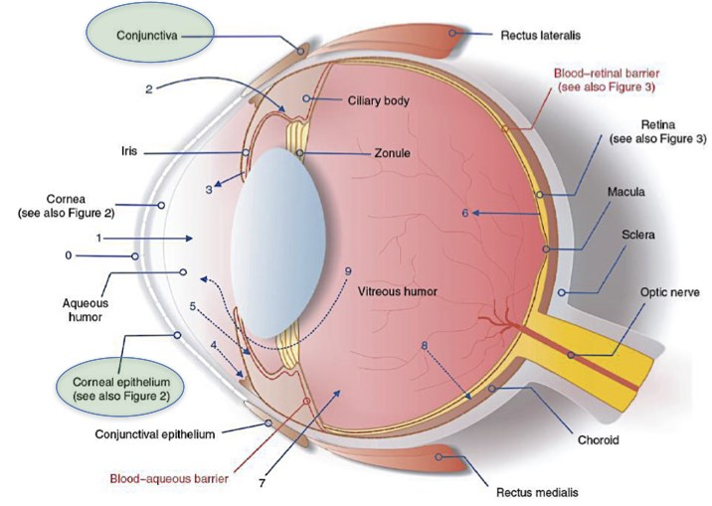
Anatomy

Slide 5
Diseases of eye:
According to the location of diseases, ocular disorders are grouped as
Periocular diseases,
Keratitis: on cornea
Trachoma: on conjunctiva
Dry Eye: composition of tears is changed, or an inadequate volume
Notes:
Keratitis: The condition in which patients have a decreased vision, ocular pain, red eye, and often a cloudy/opaque cornea. Keratitis is mainly caused by bacteria, viruses, fungi, protozoa and parasites.
Trachoma: The conjunctival inflammation is called “active trachoma” and usually is seen in children, especially pre-school children. It is characterized by white lumps in the undersurface of the upper eyelid and by non-specific inflammation and thickening often associated with papillae. This is caused by the organism Chlamydia trachomatis. Active trachoma will often be irritating and have a watery discharge.
Dry Eye: If the composition of tears is changed, or an inadequate volume of tears is produced, the symptom of dry eye will result. Dry eye conditions are not just a cause for ocular discomfort where it also results in corneal damage

Slide 6
Intraocular diseases.
intraocular infections :infections in the inner eye, including the aqueous humor, iris, vitreous humor and retina
Glaucoma, considered to be one of the major ophthalmic clinical problems in the world
Notes:
infections in the inner eye, including the aqueous humor, iris, vitreous humor and retina. They are more difficult to manage and occur commonly after ocular surgery, trauma or may be due to endogenous causes. Such infections carry a high risk for damage to the eye and also afford the possibility of spread of infection from the eye into the brain.
More than 2% of the population over the age of 40 have this disease, in which an increased intraocular pressure (IOP) greater than 22 mm Hg ultimately compromises blood flow to the retina and thus causes death of the peripheral optic nerves. This process results in visual field loss and ultimately blindness.

Slide 7
Ocular drug delivery routes pathways
I. The cornea is the main route through which ocular topically administered drugs reach the aqueous humour.
II. The blood retinal barrier (retinal pigment epithelium and retinal capilary endothelium) restricts entry of drugs from the systemic circulation into posterior segment of the eye.
III. Intravitreal delivery route to directly reach the back o the eye.

Slide 8
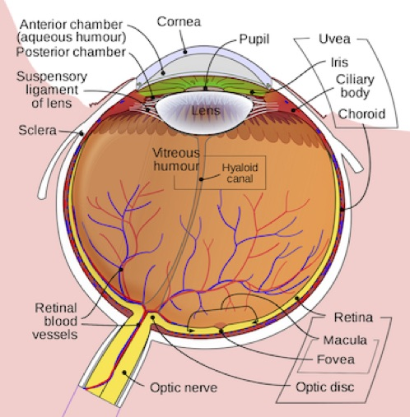
Ocular drug delivery elimination pathways
1. Drug elimination from the aqueous humour into the systemic uveoscleral circulation
2. Aqueous humour outflow through the trabecular meshwork and Schlemm’s canal.
3. Drug elimination from the vitreous humor via diffusion into the anterior chamber.
4. Drug elimination via posterior route across blood retinal barrier.

Slide 9
The oxygen and nutrients are transported to this non-vascular tissue by aqueous humor which is having high oxygen and same osmotic pressure as blood. The aqueous humor in human is having volume of 300μL that fill the anterior chamber of the eye which is in front of lens.
The cornea is covered by a thin epithelial layer continuous with the conjunctiva at the cornea-sclerotic junction
The eye is constantly cleansed and lubricated by the lacrimal apparartus which consists of four structures.
Lacrimal glands,
Lacrimal canals,
Lacrimal sac,
Nasolacrimal duct
Notes:
lacrimal fluid secreted by lacrimal glands is emptied on the surface of the conjunctiva of the upper eye lid at a turnover rate of 16% per min

Slide 10
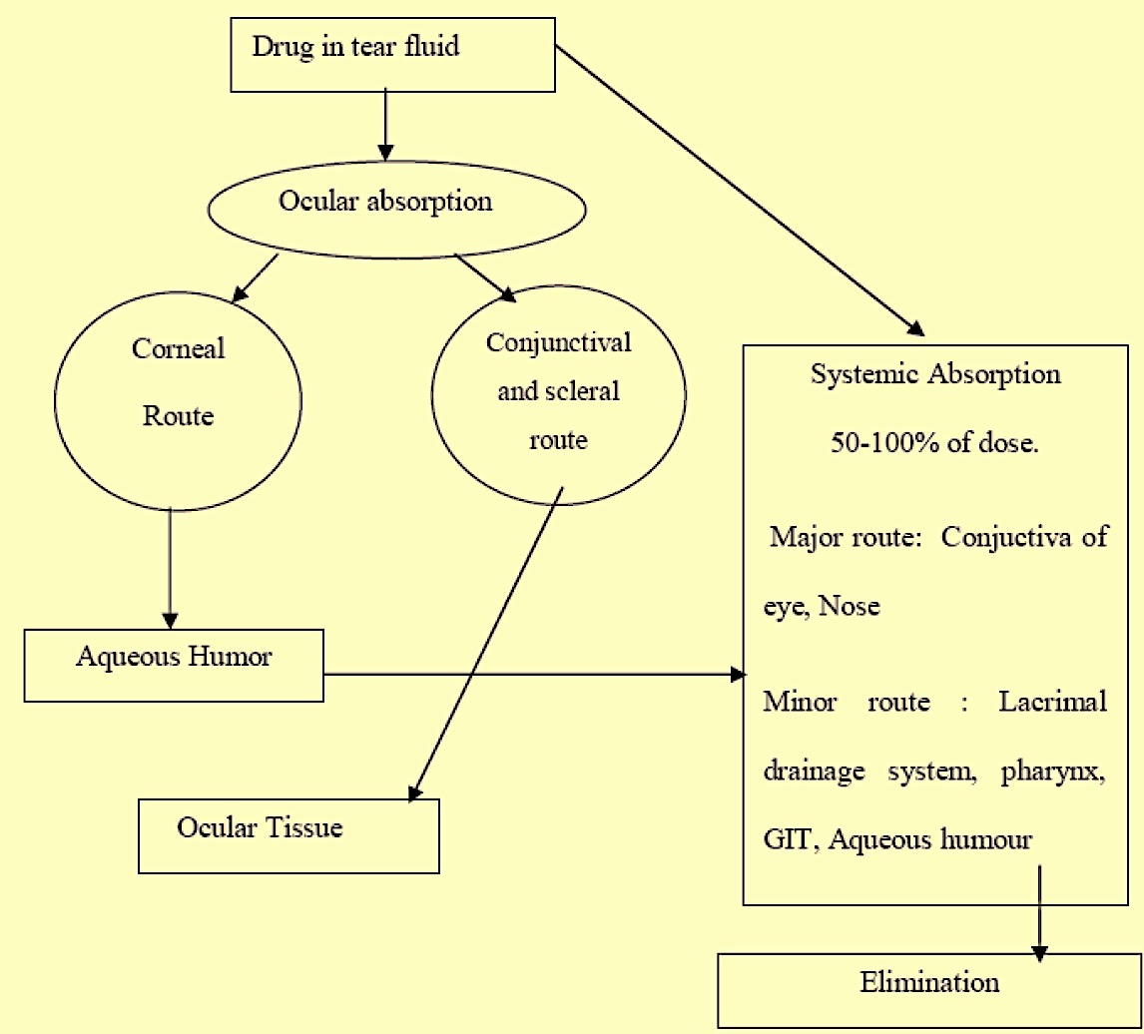
BARRIERS AVOIDING DRUG DELIVERY

Slide 11
Problems encountered by conventional ocular dosage
low capacity of the precorneal area, the optimal drop volume is about 20 μL.
Rapid precorneal drug loss due to naso -lacrimal drainage,
Tear turnover and drug dilution resulting in poor bioavailability.
to improve the ocular drug bioavailability : researches on developing controlled drug delivery systems such as:
nanoparticles, liposomes, hydrogels, ocuserts, and mucoadhesive formulations and decreasing of dose volume
offer many advantages over conventional dosage forms in terms of improving drug bioavailability, reducing toxicity and decreasing dosage frequency.
Notes:
The main problem with conventional dosage forms is eye irritation (due to drug particle size and shape) which induces lacrimation i.e. overflow on to lids, tear turn over, and due to pharmacokinetic responses like metabolism, non-specific binding and different mechanisms like diffusion, dissolution and erosion the conventional dosage forms are less advantageous [

Slide 12
OCULAR DRUG DELIVERY SYSTEMS:
Ideal control release ocular drug delivery system are:
It should not induce a foreign-body sensation or long lasting blurring.
It should possess more local activity than systemic-effects.
It must deliver the drug to the right place, i.e. in targeting the ciliary body.
It should be easy to self-administer.
The number of administrations per day should be reduced.

Slide 13
Mechanism of ocular drug absorption
Non-Corneal Absorption
Penetration across Sclera & Conjuctiva into Intra Ocular tissues•
Non-Productive: because penetrated drug is absorbed by general circulation.
Corneal Absorption
Outer Epithelium: rate limiting barrier, with pore size 60A (small ionic and lipophilic molecules)
Trans cellular transport: transport between corneal epithelium & stroma

Slide 14
Classes Of Ophthalmic Dosage Form
Based on physical form
Aq. Solutions
Aq. Suspension
Ointments
Gels
Lotions
Solid Insert
Based on Route of Adm.
Topical solutions:
Intra-ocular solutions
Ophthalmic solution Injections:
Notes:
1-Topical Solutions: Multiple Dose container With Preservatives.
2. Intra-ocular Solutions: For Surgery, Single dose, Without preservative.
3.Ophthalmic SolutionsInjections: Intra-ocular injection, given in eye tissues, without preservative

Slide 15
The primary approaches in the design of control release ODDS
attempt to slow down the drainage of drug by tear flow.
The various formulations are explained as below
A - Ophthalmic Solutions of Drug Resinates:
The first successful control release ophthalmic product for topical application using ion exchange resin technology for treatment of glaucoma was betaxolol ionic suspension (Betoptic S, 0.25%).
In this the drug is bound to Amberlite resin, a cationic exchange resin of sulphonic acid styrene-vinyl copolymer.
The solution is also having carbomer(Carbopol 934P) which acts as an viscosity enhancer which helps in increasing the residence time of product in eye

Slide 16
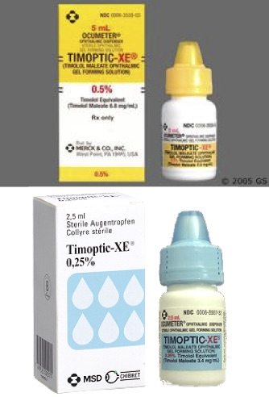
The primary approaches in the design of control release ODDS
B - Viscous solutions and Hydrogels :
hydrogels is addition of hydrocolloids to aqueous drug solutions. Commonly used polymers in these formulations are cellulose derivatives, carbomers, polysaccharides, polyvinyl alcohol, polyvinyl pyrrolidone and recently, hyaluronic acid.
Gels permit longer residence time in the precorneal area than viscous solutions. Hence, the drug solution that gels in the conjuctival cul-de-sac and it is more acceptable. Hence these formulations are referred to as in-situ gel forming systems
The mechanisms which form sol to gel transition in the conjunctival pouch are due to change in pH, temperature, or due to change in ionic environment. E.g. Timolol formulation based on the gellan gum undergoes sol to gel transition due to the ionic content of the tears.

Slide 17
The primary approaches in the design of control release ODDS
C. Mucoadhesive Formulations :
Mucoadhesion is based on entanglement of non-covalent bonds between polymers and mucous. Commonly used polymers in these formulations are many high molecular weight polymers with different functional groups like carboxyl, hydroxyl, amino and sulphate which are capable of forming hydrogen bonds and not crossing biological membranes.
The Charged polymers i.e. both anionic and cationic polymers show better mucoadhesive capacity than the non-ionic ones.
Anionic polymers: Sodium alginate, Poloxamer, Carbomer, Sodium Carboxy Methoxy Cellulose.
Cationic polymers: Chitosan.
This formulation helps in increasing the residence time of drug in the eye.

Slide 18
The primary approaches in the design of control release ODDS
D. Dispersed Systems :
These are based on liposomes, nanoparticles or nanocapsules and the development of nanoproducts was very challenging
Lipsomes: The potential advantages achieved with the liposomes are the control of the rate of encapsulated drug and protection of the drug from the metabolic enzymes present at the tear corneal epithelium interface. The drawbacks associated with the liposomes in ocular drug delivery are due to short shelf life, limited loading capacity and obstacles such as sterilization of the preparation.
Nanoparticles
This approach is considered mainly for the water soluble drugs. Nanoparticles are particulate drug delivery systems 10-1000 nm in the size in which the drug may be dispersed, encapsulated or absorbed.
The polymers used for the preparation of ophthalmic nanoparticles are rapidly bio-degradable. Hence the nanoparticles are very promising as targeted drug carriers to inflamed region of the eye.

Slide 19
The primary approaches in the design of control release ODDS
E. Ophthalmic-Inserts Ophthalmic inserts are aimed at remaining for a long period of time in front of the eye. These solid devices are intended to be placed in the conjunctival sac and to deliver the drug at a comparatively slow rate.
The advantages of these systems are:
Ocular contact time is increased.
Accurate dosing is possible.
Constant and predictable rate of drug release can be achieved.
Systemic absorption can be reduced and side effects can be reduced.
Increased shelf life can be achieved Better patient compliance.
Targeting to internal ocular tissues can be done.
Types:
Non-erodible ocular insert: include Ocusert, and Contact lens.

Slide 20
Thank you

